Slide 1
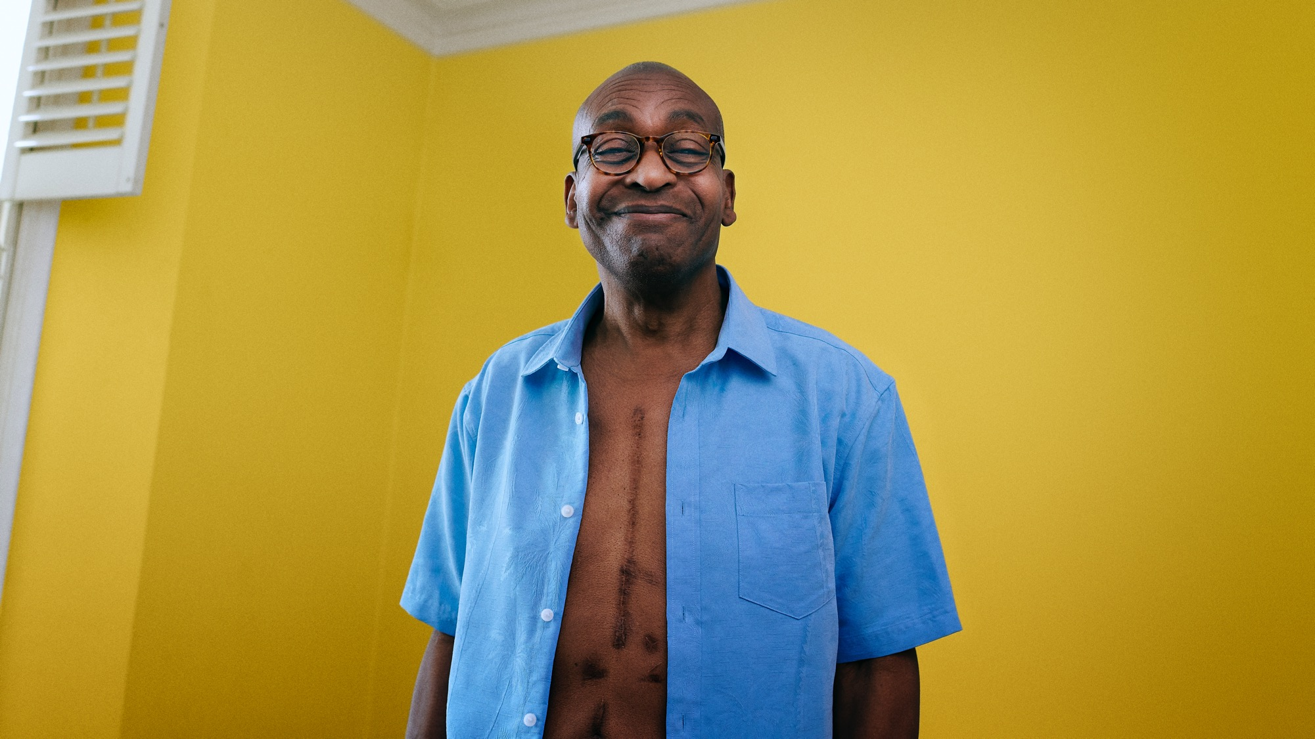


BRIDGING
THE GAP:
Understanding how to support people with long term health conditions to become more physically active
Published April 2024
Copyright 2024 We Are Undefeatable

Slide 2
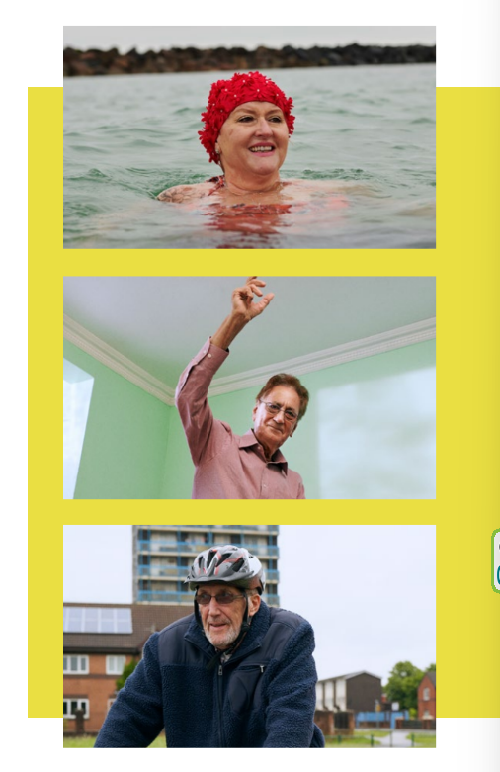

BACKGROUND TO WE ARE UNDEFEATABLE
A movement supporting people with long term health conditions (LTHCs) to be physically active in ways that work for them. Resources constantly developing and include ideas on ways to move, tips for getting started and workouts.
Supported by Sport England with National Lottery funding and led by The Richmond Group of Charities in collaboration with Mind, MS Society and Parkinson’s UK.
Vision: be the go-to resource to support people living with LTHCs to start and stay active, by galvanising and connecting people to enjoy the benefits of ongoing activity.

Slide 3
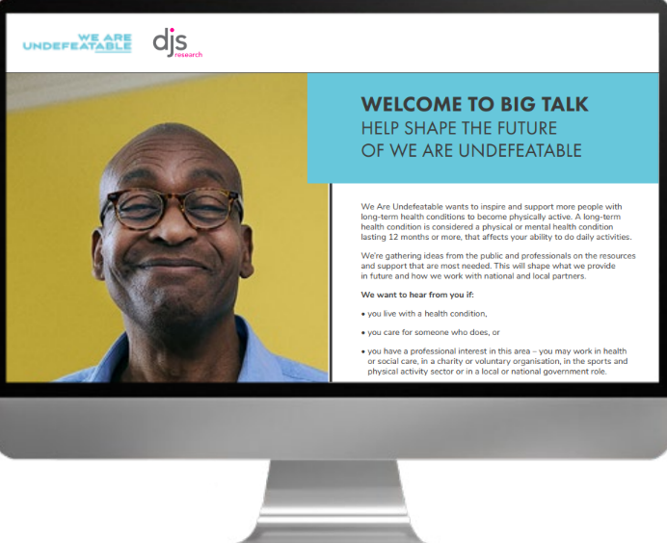
THE PUBLIC CONSULTATION
Conducted in September 2023 to inform future resources based on the needs of people with LTHCs, and the people and organisations who support them.
DJS Research Ltd hosted the consultation and supplemented responses from key audiences via a panel survey.
Accessibility enhanced through survey design, completion by proxy, and telephone and email completion options.

Slide 4
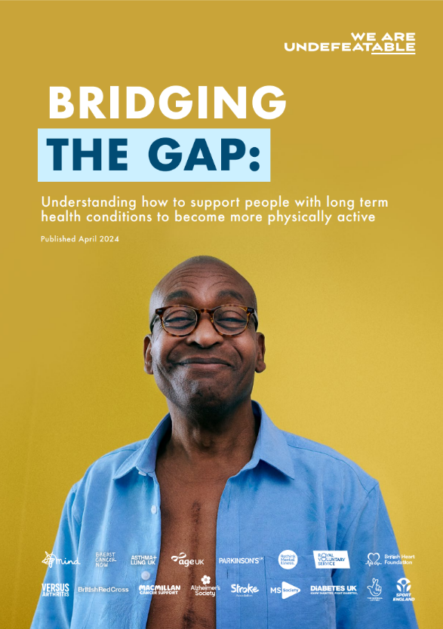
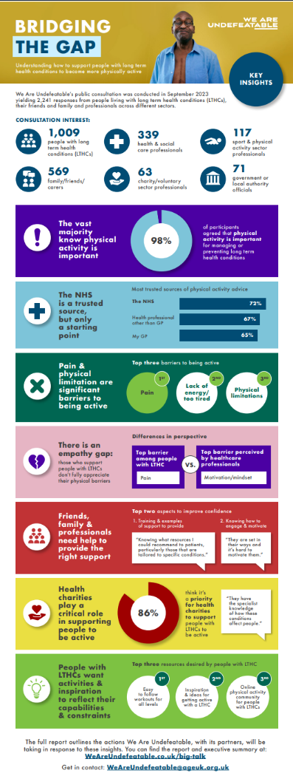

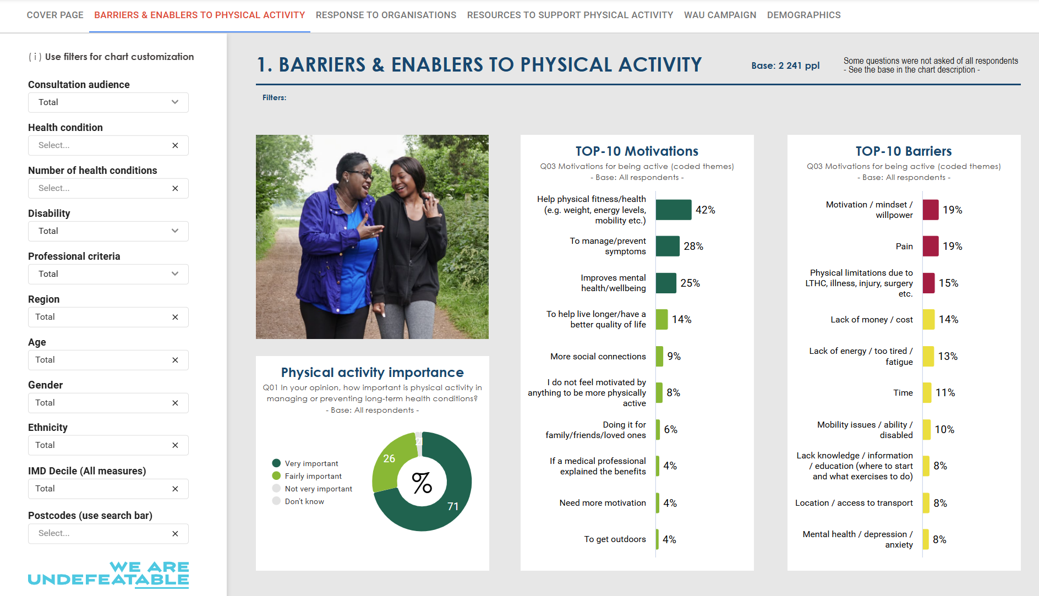
FREE RESOURCES
Find and share the full 48-page pdf report, exec summary & infographic:
weareundefeatable.co.uk/big-talk
Access insights for your audiences of interest via the dashboard:
Big Talk Dashboard
For further information contact the team at WeAreUndefeatable@ageuk.org.uk

Slide 5
CONSULTATION TOPICS
How much
of a priority
is physical activity?
What are the barriers to being active?
What are
the barriers
to providing support to those who need it?
What resources would help?
What’s the role of We Are Undefeatable and other organisations?

Slide 6






CONSULTATION RESPONSE
No weighting has been applied to the data, therefore results are only reflective of those that took part. Further sample detail can be found in the appendix.
1,009
people with long term health conditions (LTHCs)
569
family/friends
/carers
339
health and social care professionals
63
charity/voluntary sector professionals
117
sport & physical activity sector professionals
71
government or local authority officials

Slide 7
Key Learnings
BRIDGING
THE GAP:
Many turn to the healthcare system for advice on getting active but the NHS cannot adequately address their needs by itself.
There is an ‘empathy gap’ whereby those who support people with LTHCs do not fully appreciate their pain and physical barriers to being active.
Family, friends and carers are key enablers but lack confidence and fear making things worse. They need practical advice on what to recommend.
Health charities are in a strong position to support physical activity and their involvement in WAU is critical.
People with LTHCs want workouts appropriate to their capabilities combined with inspiration they can relate to.
Professionals want insight and/or practical resources depending on their context, but also raise the need for greater local engagement.

Slide 8
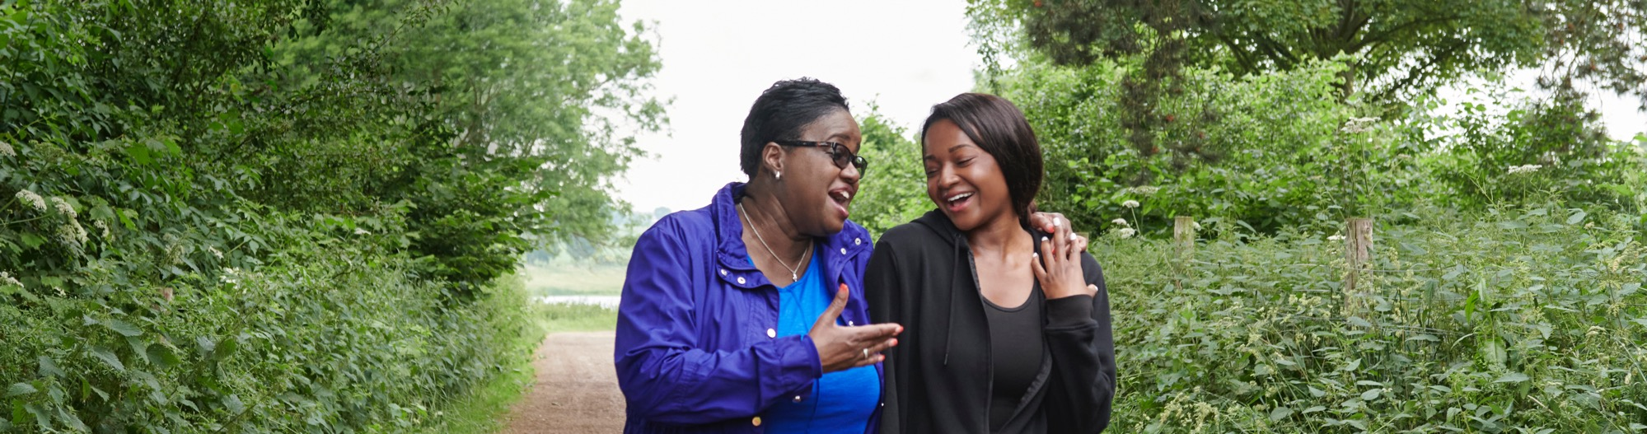
1. ‘GOOD FOR THE BODY & SOUL’:
The importance of physical activity when managing a long term health condition

Slide 9
ALMOST EVERYONE KNOWS IT’S KEY FOR
PEOPLE WITH LTHCs TO BE PHYSICALLY ACTIVE
% agree ‘physical activity is important in managing or preventing long term health conditions’
People with LTHCs
Family/friends/ carers
Health & social care professional
Charity / voluntary professionals
Sport and physical activity professionals
Government professionals
96%
98%
100%
100%
97%
99%

Slide 10
“It is good for the body and soul. Fresh air is good, and some sun exposure. Activities that are social are good for the mind. Relieves boredom and monotony, sets challenges, can bring improvement physically and mentally.”
Family/friend/carer of person with a LTHC

Slide 11
THE MOTIVATIONS EXPRESSED FOR
BEING ACTIVE FALL INTO THREE CATEGORIES
42%
Physical health/fitness
28%
Manage symptoms
25%
Mental health
“Weight loss, increase
strength and stamina”
“To try and manage my back issues
and prevent them getting worse.”
“A nice walk always helps clear the head.”
“I regularly go out walking for two
hours a day after work with my dog…
it makes me feel better in myself.”
“To be healthier for my kids”
“Being as physically active as possible means a reduction in stiffness and pain.”
“Staying active also ensures
sleep rhythm remains consistent.”
“I exercise regularly to prevent flare ups with my fibromyalgia and osteoarthritis.”
“I also exercise to control my endorphins which help with my mood and mental health.”

Slide 12
TOP 3 MOTIVATIONS FOR DOING PHYSICAL ACTIVITY:
SINGLE VS. MULTIPLE LTHC
Whether you have one long term condition or multiple conditions, the most common motivation for being active is physical health and fitness.

Slide 13
TOP 3 MOTIVATIONS FOR DOING PHYSICAL ACTIVITY: BY LTHC
The three areas of motivation are largely consistent across conditions. Mental health benefits rank more highly for people with an existing mental health condition and for those with breast cancer, while quality of life is top motivator for those with a lung condition.
Arthritis (n=417) | Back pain (n=273) | A limiting mobility condition (n=180) | Breast cancer (n=58) | Cancer (exc. breast) (n=62) | Heart conditions (n=174) | Stroke (n=71)
Physical health/fitness | Physical health/fitness | Physical health/fitness | Physical health/fitness | Physical health/fitness | Physical health/fitness | Physical health/fitness
Manage symptoms | Manage symptoms | Manage symptoms | Mental health | Mental health | Manage symptoms | Manage symptoms
Mental health | Mental health | Mental health | Manage symptoms | Manage symptoms | Mental health | Mental health
1
2
3
Asthma (n=170) | Lung conditions/ COPD* (n=69) | Type 1 Diabetes (n=42) | Type 2 Diabetes (n=142) | Long term depression (n=171) | Long term anxiety disorder (n=185) | Severe mental health condition** (n=89)
Physical health/fitness | Physical health/fitness | Physical health/fitness | Physical health/fitness | Physical health/fitness | Physical health/fitness | Mental health
Mental health | Manage symptoms | Manage symptoms | Manage symptoms | Mental health | Mental health | Physical health/fitness
Manage symptoms | Quality of life | Mental health | Mental health | Manage symptoms | Manage symptoms | Manage symptoms
1
2
3

Slide 14
“I am battling so many different issues that it makes physical activity very difficult but, when I am able to, I find that it helps my mobility and my energy levels.”
Person living with arthritis, heart condition, chronic fatigue and fibromyalgia

Slide 15

2. THE NHS IS A TRUSTED SOURCE,
BUT ONLY A STARTING POINT

Slide 16
THE STARTING POINT FOR TRUSTED ADVICE IS THE NHS
People naturally turn to the healthcare system for advice on how to get active with a LTHC.
However, many verbatim responses point to the challenges faced by the NHS and the fact that the healthcare system cannot succeed alone in the mission of supporting more people with LTHC to be physically active.
Most trusted sources of physical activity advice/information

Slide 17
“32 years in the NHS and we always focus on managing ill health through medical interventions, we aren’t very good at doing the primary or secondary preventative services…most patients with a long term condition get one annual assessment a year, meds reviewed & then they are on their own for the other 363 days unless they have an exacerbation, then they are seen as a problem patient.”
General Practitioner

Slide 18

3. WHY IT CAN BE HARD
TO GET ACTIVE

Slide 19
PAIN, LOW ENERGY AND PHYSICAL LIMITATIONS ARE THE PRIMARY BARRIERS TO ACTIVITY
Top 10 barriers to physical activity cited by people with LTHCs

Slide 20
TOP 3 BARRIERS TO PHYSICAL ACTIVITY: BY LTHC
The theme of physical limitation was dominant across a wide range of LTHCs, with verbatim evidence highlighting the extent to which such challenges can affect motivation.
Arthritis (n=417) | Back pain (n=273) | A limiting mobility condition (n=180) | Breast cancer (n=58) | Cancer (exc. breast) (n=62) | Heart conditions (n=174) | Stroke (n=71)
Pain | Pain | Pain | Lack of energy/ too tired | Physical limitations | Pain | Lack of energy/ too tired
Lack of energy/ too tired | Lack of energy/ too tired | Lack of energy/ too tired | Physical limitations | Lack of energy/ too tired | Physical limitations | Mobility
Mobility issues | Physical limitations | Mobility issues | Pain | Pain | Lack of energy/ too tired | Physical limitations
1
2
3
Asthma (n=170) | Lung conditions/ COPD* (n=69) | Type 1 Diabetes (n=42) | Type 2 Diabetes (n=142) | Long term depression (n=171) | Long term anxiety disorder (n=185) | Severe mental health condition** (n=89)
Pain | Breathing difficulty | Physical limitations | Physical limitations | Depression / anxiety | Pain | Depression / anxiety
Lack of energy/ too tired | Physical limitations | Time | Pain | Pain | Depression / anxiety | Motivation / mindset
Physical limitations | COPD | Pain | Lack of energy/ too tired | Lack of energy/ too tired | Motivation / mindset | Lack of energy/ too tired
1
2
3

Slide 21
“I get tired very quickly. My bones can get very inflamed and painful”
Person living with arthritis

Slide 22

4. THE EMPATHY GAP:
A mismatch between lived experiences
& perspectives from the system

Slide 23
IT’S UNCLEAR THAT THE ‘SYSTEM’ RECOGNISES THE
PHYSICAL BARRIERS FACED BY PEOPLE WITH LTHCs
People with LTHCs cite
top barriers to PA:
VS.
What others think are the top barriers for them:
Family/friends carers
Health & social
care professionals
Charity / voluntary professionals
Sport & physical activity professionals
Government professionals
1st
Pain
(21%)
Motivation/
mindset (23%)
Motivation/
mindset (36%)
Cost
(40%)
Cost
(21%)
Cost
(24%)
2nd
Lack of
energy (19%)
Pain
(19%)
Cost
(29%)
Lack info/ knowledge (32%)
Location/
access
(16%)
Motivation / mindset (23%)

Slide 24
“They are set in their ways and it’s hard to motivate them.”
Family/friend/carer of person with a LTHC
“The main barriers include a lack of motivation, will power, fear of getting hurt, abilities and confidence.”
Sport and physical activity sector professional

Slide 25

5.THE ISSUE OF CONFIDENCE AMONG FAMILY & FRIENDS

Slide 26
FAMILY/FRIENDS/CARERS LACK CONFIDENCE SUPPORTING PEOPLE
WITH LTHCs TO BE ACTIVE BUT PROFESSIONALS ALSO COULD IMPROVE
Confidence supporting people with LTHCs to be physically active
62%
81%

Slide 27
CONFIDENCE AMONG FAMILY/FRIENDS/ CARER VARIES SIGNIFICANTLY BY LTHC: IT’S LOWEST FOR DEMENTIA, PARKINSON’S, HEART CONDITIONS & STROKE
Confidence supporting people with LTHCs to be active among family/friends/carers
Not very/not at all confident
Fairly/very confident
Condition of person cared for

Slide 28
“I care for an elderly parent – just trying to get her to have a walk to the end of the road is exhausting and painful, [I need to know] I’m not making things worse.”
Family/friend/carer of person with a LTHC

Slide 29

6. THE NEED FOR PRACTICAL GUIDANCE

Slide 30







PROFESSIONALS AND FAMILY/FRIENDS/CARERS WANT GUIDANCE ON APPROPRIATE PHYSICAL ACTIVITY TO RECOMMEND
What would help you be more confident supporting people with LTHCs to be active?
Both professionals and family/ friends/carers are most likely to want training and examples of support to provide as well as a better understanding of how to motivate others.
Professionals also point to the need for easily accessible resources, better knowledge of local services and more time to discuss physical activity.

Slide 31
“Advice on do’s and don’ts. Knowing what are the limitations for a specific person’s needs (not one size/approach fits all) would improve my confidence.”
Family member caring for person with LTHC
“Easy access to a central up-to-date online resource of accurate and relevant information to share with teams and service users, covering a full range of long term conditions and information about what physical activity is safe, effective and at all levels for differing age ranges and capabilities.”
Healthcare professional
“It would be useful to co-design
with system leaders locally at
place, measure impact & then
share the principles of values that provided the foundation of what works well with other leaders to adapt & adopt.”
Healthcare professional
“I feel that the advice I give rarely makes any difference. I would be keen to know about evidence based motivational interviewing to encourage people to exercise.”
Healthcare professional

Slide 32

7.THE IMPORTANCE OF CHARITIES IN ENABLING PHYSICAL ACTIVITY

Slide 33
MORE PEOPLE EXPECT HEALTH CHARITIES THAN THE NHS TO PRIORITISE THE PHYSICAL ACTIVITY AGENDA
Proportion who think supporting people with LTHCs to be active is a high or medium priority for:

Slide 34


9 IN 10 THINK CHARITY INVOLVEMENT IN WE ARE UNDEFEATABLE IS IMPORTANT
Proportion who say charity involvement in WAU is very or fairly important
Charities are felt to play a role no other organisations can play, due to their expertise and credibility relating to the management of specific LTHCs, combined with local reach and connections.

Slide 35
“They [health charities] have the specialist knowledge of how these conditions affect people.”
Family/friend/carer of someone with a LTHC
“They are high profile and have credibility.”
Healthcare professional
“They [health charities] have a reach that local authorities and ‘the system’ do not and have a kudos and reliability that instils trust.”
Local government professional
“They are the ones that know their audience the best and the co-creation element is crucial.”
Sport & physical activity professional

Slide 36
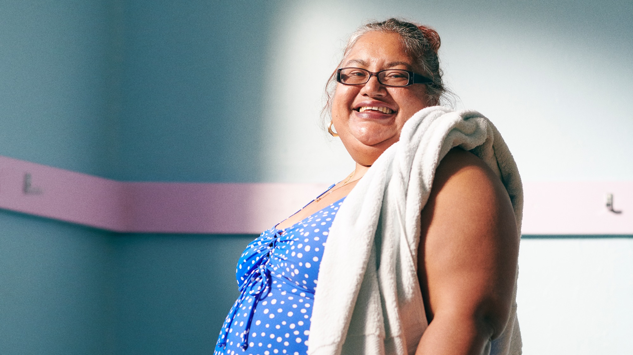
THE FUTURE

Slide 37
HIGHEST RANKING RESOURCE IDEA FOR PEOPLE WITH LTHCs IS EASY TO FOLLOW WORKOUTS FOR ALL CAPABILITIES
People with LTHCs are most interested in a practical resource offering tailored physical activity suited to each individual.
The second most rated resource – a website for inspiration – reflects WAU’s long standing focus on sharing relatable stories, ideas on ways to move and tips for getting started.
Proportion of people with LTHCs who would find each resource ‘very useful’

Slide 38
TOP RANKED RESOURCE IDEAS: SINGLE VS. MULTIPLE LTHC
The top two resources were the same for those living with single and multiple long term health conditions.
1st
2nd
3rd
4th
5th
Single LTHC
Workout library
Website with inspiration
Mobile app
Online community
TV channel
2+ LTHCs
Workout library
Website with inspiration
Online community
TV channel
Mobile app
3+ LTHCs
Website with inspiration
Workout library
Online community
TV channel
Mobile app

Slide 39
TOP RANKED RESOURCE IDEAS: PROFESSIONALS
1st
2nd
3rd
Health & social care
Printable resources to share with people with LTHCs
42%
Printable assets to display in clinical spaces to promote physical activity
42%
Research to make the case to prioritise physical activity for people with LTHCs 41%
The usefulness of each resource idea varied by sector:
Health and social care professionals were attracted to printable resources to deploy in their setting.
Charity, voluntary and government staff responded best to comms support to promote physical activity.
Sport and physical activity professionals were interested in research to make the case for physical activity for people with LTHCs, and in fostering collaboration.
Separate open-ended responses also raised the opportunity for greater local engagement and coordination.
Charity / voluntary
Comms guidance for promoting physical activity to people with LTHCs
63%
Research to make the case to prioritise physical activity for people with LTHCs 59%
Comms assets that can be tailored to your organisation or role
57%
Sport & PA
Research to make the case to prioritise physical activity for people with LTHCs 56%
Ways to connect with professionals to share info and be canvassed on opinion
54%
Webinars to better understand physical activity for people with LTHCs
54%
Government
Comms guidance for promoting physical activity to people with LTHCs
56%
Case studies from organisations with successful physical activity initiatives
49%
Research to make the case to prioritise physical activity for people with LTHCs 48%

Slide 40
“People want to know their local – as well as national – resources/contacts. Anything that can be tailored into local comms is welcome.”
Healthcare professional
“It would be useful to co-design with system leaders locally at place, measure impact & then share the principles of values that provided the foundation of what works well with other leaders to adapt & adopt.”
Healthcare professional
“Funding to small community organisations who are in contact with their local community.”
Community organisation employee

Slide 41
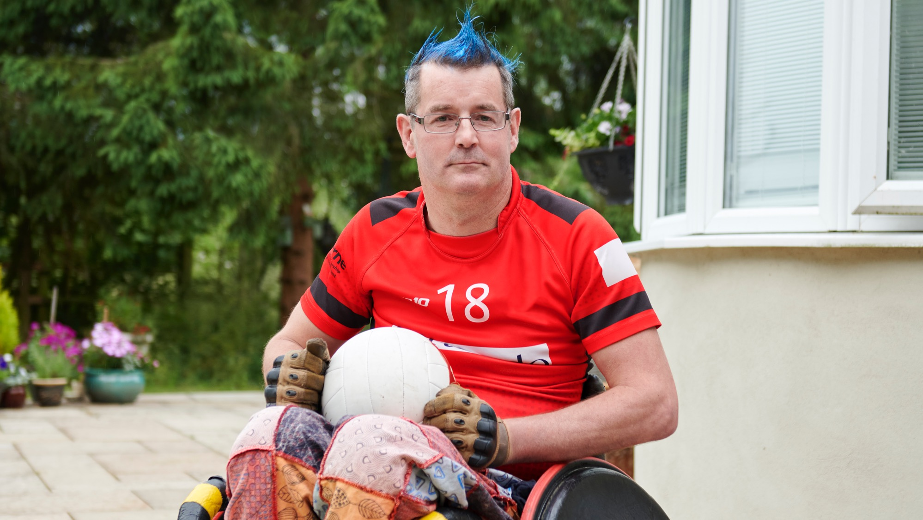
CONCLUSIONS:
Next steps for
We Are Undefeatable

Slide 42
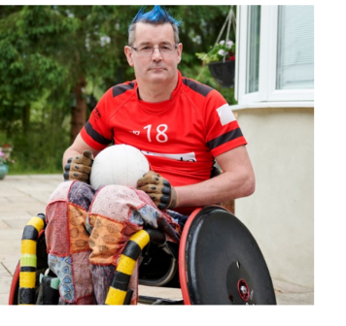
WE ARE UNDEFEATABLE WILL ACT DIRECTLY ON MANY OF THE FINDINGS
In relation to people living with LTHCs and their close carers, we will:
1. Increase prominence and input of partner charities throughout our resources
In response to the need for trusted advice and importance of health charity involvement.
4. Explore ways to significantly enhance our library of online workouts
In response to the need for practical resources to support getting active.
2. Account for a wide range of capabilities & barriers
In response to the need for tailored guidance and reassurance on suitable forms of activity.
5. Explore facilitating social connection between people facing similar challenges
In response to the interest in a community – including promoting partner charity peer-to-peer support offerings.
3. Provide dedicated guidance for family/ friends/carers
To help them feel more confident supporting those they care for to be active.

Slide 43
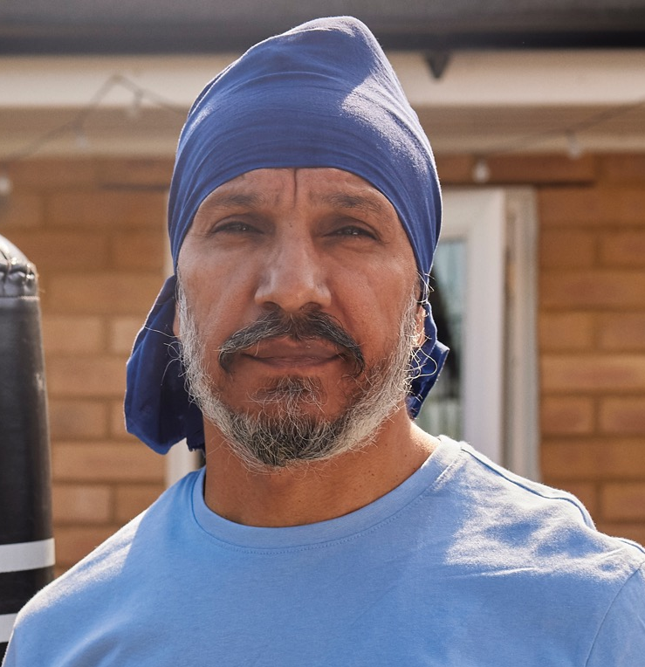
WAU WILL ALSO ENGAGE SECTOR PARTNERS
Working with our partners at the Richmond Group of Charities and Sport England, we will:
1. Redevelop the We Are Undefeatable supporters hub
In order to provide more tailored content and improve the experience.
3. Aim to make We Are Undefeatable part of the universal offer of Integrated Care Systems in England
Building physical activity into the health and care system, by bringing insights and resources into healthcare professional education and advocating for policy change in an upcoming manifesto about physical activity and health.
2. Continue to develop resources under guidance of charity partners and exercise professionals
In response to the need for greater confidence when signposting to appropriate physical activity.
4. Explore ways to significantly enhance our library of online workouts
In response to the need for practical resources to support getting active.
WE PLAN TO REPORT ON ALL STEPS TAKEN AND THEIR IMPACT AT END OF 2024

Slide 44
Visit WeAreUndefeatable.co.uk for more information
Or contact WeAreUndefeatable@ageuk.org.uk

Slide 45
APPENDIX

Slide 46
APPENDIX: SAMPLE BREAKDOWN (1/3)
Demographic profile of all consultation participants, n=2,241
Area
North West England | 16%
South East England excl. London | 15%
London | 12%
East Midlands | 10%
East of England | 10%
South West England | 10%
Yorkshire & the Humber | 9%
West Midlands | 8%
North East England | 5%
Scotland | 2%
Wales | 2%
Northern Ireland | 1%
Gender
Female | 60%
Male | 39%
Disability
Identify as disabled | 61%
Not disabled | 36%
Age
Under 20 | * (n=9)
20-29 | 6%
30-39 | 14%
40-49 | 18%
50-59 | 23%
60-69 | 23%
70+ | 15%

Slide 47
APPENDIX: SAMPLE BREAKDOWN (2/3)
Specific LTHCs among those with LTHCs, n=1,009
Arthritis (Osteoarthritis, Rheumatoid Arthritis, other) | 41%
Back pain | 27%
Long term anxiety disorder | 18%
A long term limiting mobility condition | 18%
Heart disease, hypertension (or other hear related condition) | 17%
Long term depression | 17%
Asthma | 17%
Type 2 Diabetes | 14%
Severe mental health condition (e.g. schizophrenia, bipolar disorder, obsessive compulsive disorder, personality disorder) | 9%
Stroke | 7%
Chronic Obstructive Pulmonary Disease/Lung Condition | 7%
Cancer (excluding breast) | 6%
Breast cancer | 6%
Type 1 Diabetes | 4%
Multiple Sclerosis | 2%
Parkinson’s | 2%
Dementia (including all types of dementia such as Alzheimer’s Disease & Vascular dementia) | *
Other | 1%
Specific LTHCs cared for by family/friends/carers, n=569
Arthritis (Osteoarthritis, Rheumatoid Arthritis, other) | 27%
Back pain | 16%
Heart disease, hypertension (or other hear related condition) | 16%
A long term limiting mobility condition | 16%
Type 2 Diabetes | 15%
Long term anxiety disorder | 13%
Long term depression | 12%
Dementia (including all types of dementia such as Alzheimer’s Disease & Vascular dementia) | 12%
Cancer (excluding breast) | 10%
Asthma | 10%
Severe mental health condition (e.g. schizophrenia, bipolar disorder, obsessive compulsive disorder, personality disorder) | 8%
Stroke | 7%
Chronic Obstructive Pulmonary Disease/Lung Condition | 7%
Type 1 Diabetes | 4%
Parkinson’s | 4%
Breast cancer | 2%
Multiple Sclerosis | 1%
Other | 17%
31 respondents did not answer this question

Slide 48
APPENDIX: SAMPLE BREAKDOWN (3/3)
Sector profile of professional interest participants, n=618
Healthcare: local | 33%
Healthcare: national | 20%
Sport & physical activity | 19%
Charity/voluntary organisation | 10%
Government: local | 8%
Government: national | 3%
Social care | 2%
Academia | 1%
Community organisation | 1%
Marketing services | *
Other | 2%
Organisations represented by health & social care participants, n=338
NHS Trust | 49%
NHS funded health or social care provider (e.g. hospital, GP surgery, care homes, clinics) | 31%
Independent health or social care provider (e.g. BUPA, Four Seasons etc.) | 6%
Integrated Care Board | 4%
NHS Horizons | 1%
Other | 10%
Organisations represented by sport and physical activity sector participants, n=117
Sport England | 24%
Leisure operator/centre | 11%
Community or local sports club | 11%
Independent trainer, instructor or coach | 11%
National sports governing body | 8%
Active Partnership | 7%
Local authority | 7%
Membership organisation (e.g. UK Active) | 6%
Society, coalition or association (e.g. Sport & Recreation Alliance, Activity Alliance, BSLM, Sport for Development) | 3%
Workforce & standards body (e.g. UK Coaching, CIMSPA, Quest) | 3%
Other | 10%

